Slide 1
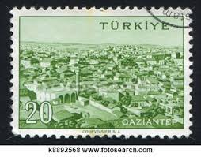
Designstudio
Großes Entwerfen 253.617 (8h), Bachelor-Entwerfen 253.618 (8h) ISOVER Multi - Comfort House School of tomorrow Gaziantep,
Turkey, East-Anatolia
Zweistufiger internationaler Entwurfswettbewerb
Betreuer: Karin Stieldorf Manfred Berthold
Klaus Krec
Marjan Maftoon

Slide 2
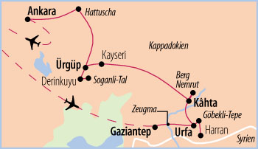
2-stage international competition
Participants: Students Organizer: Saint-Gobain ISOVER
Prizes:
1st stage – national:
1st prize 1500€
2nd prize 1000€
3rd prize 500€
2nd stage – international:
1st prize 1500€
2nd prize 1000€
3rd prize 750€
Final Awards given in Buchuresti, May 28-31 invitation by Saint-Gobain ISOVER
international competition

Slide 3
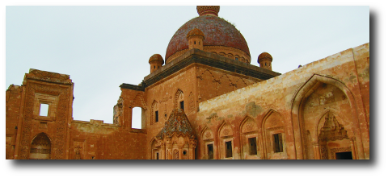
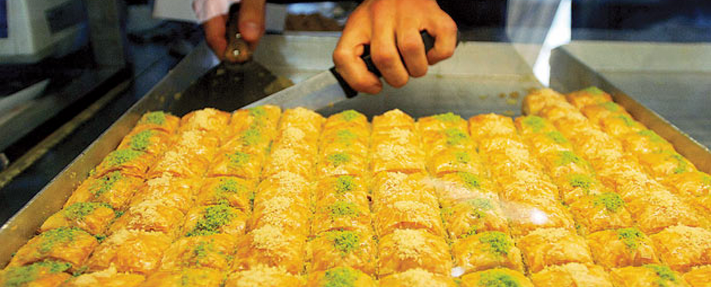
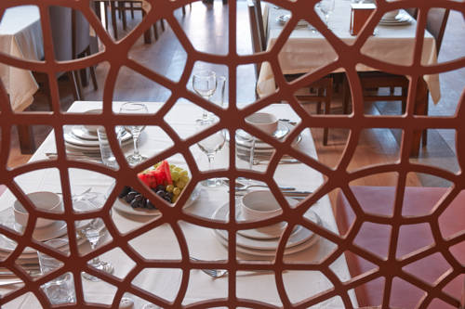
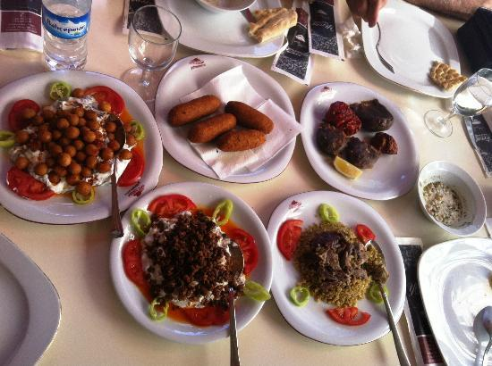

Slide 4
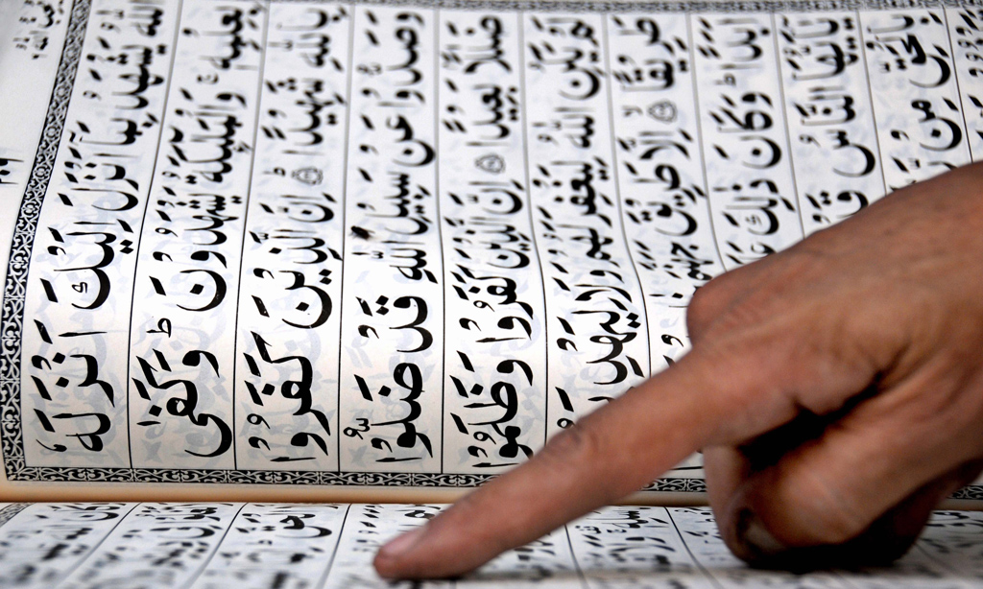
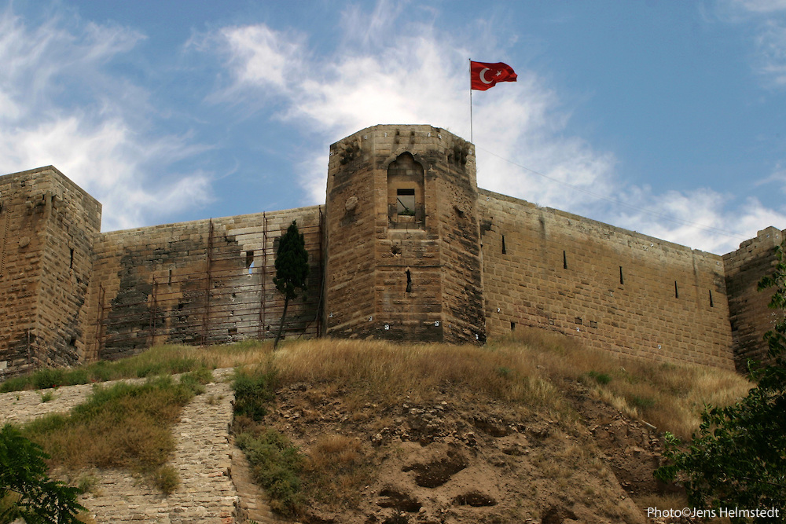
Entwurf nachhaltiger Gebäude-konzepte für eine Schule mit Platz für 400 bis 600 Kinder im Alter zwischen sechs und zehn Jahren, die allen Nutzern ein hohes Maß an Komfort bietet. Entstehen soll sie am Rande der türkischen Stadt Gaziantep nahe der syrischen Grenze, wo im Rahmen des sogenannten Eco Projects eine komplette Wohnsiedlung für 200.000 Einwohner geplant ist. In dem Entwurf für das Schulgebäude sollen moderne Lernkonzepte integriert und lokale Gegebenheiten berücksichtigt werden.
task

Slide 5
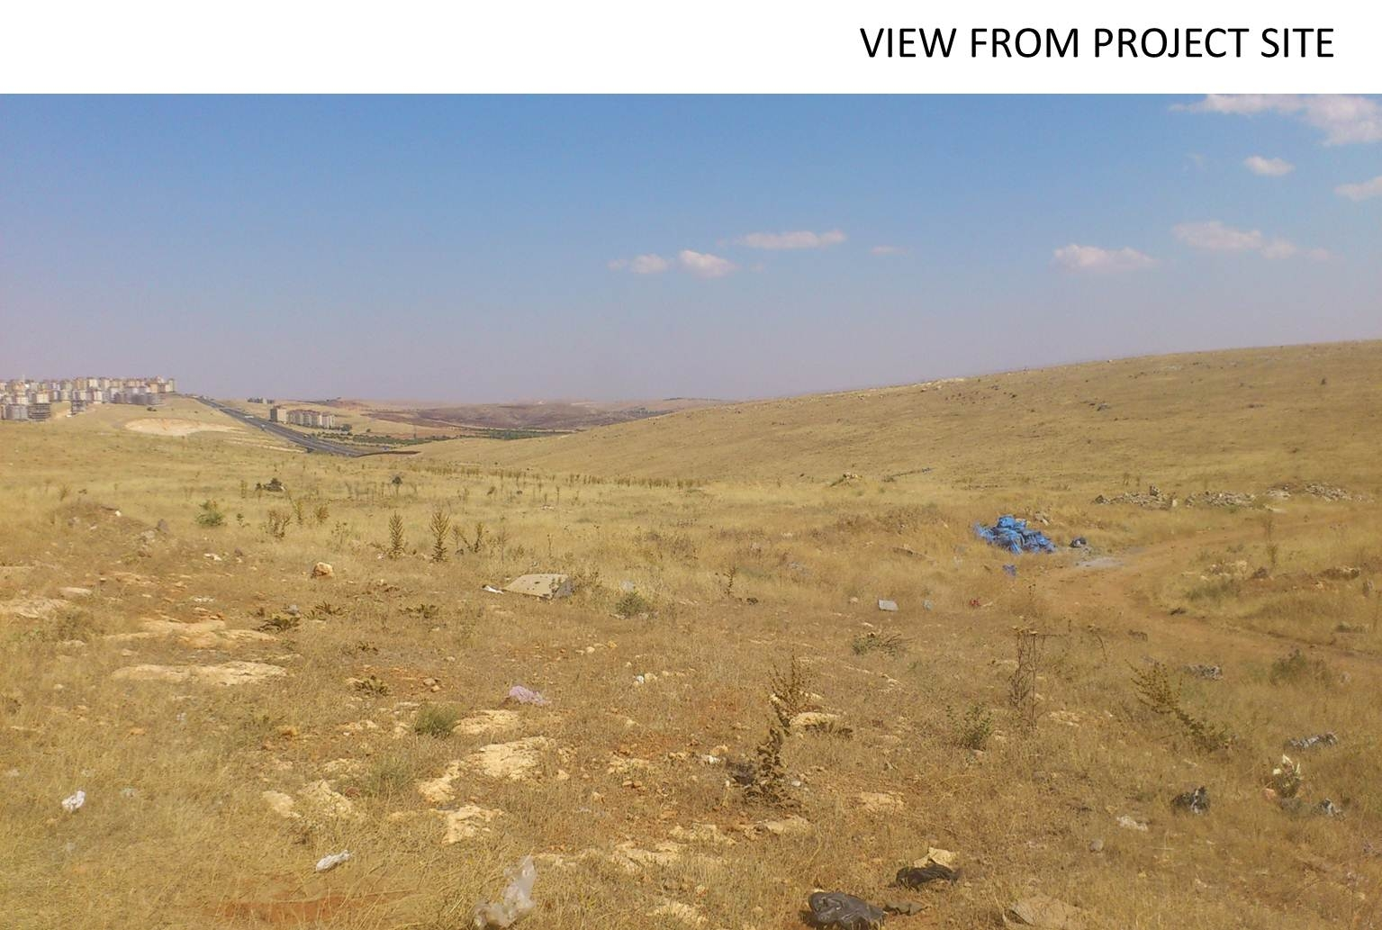
east and west elevation

Slide 6
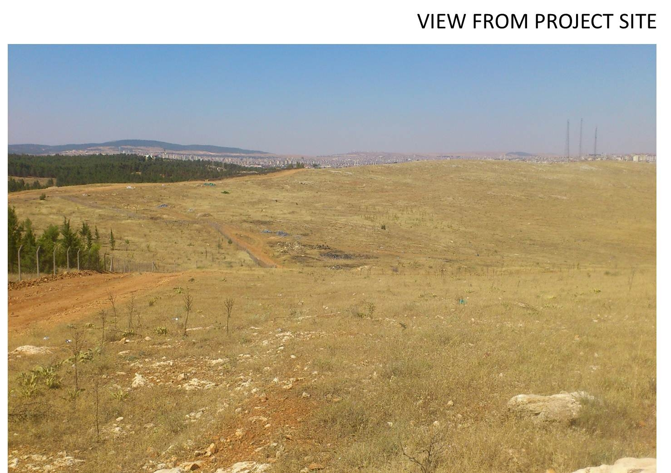

Slide 7
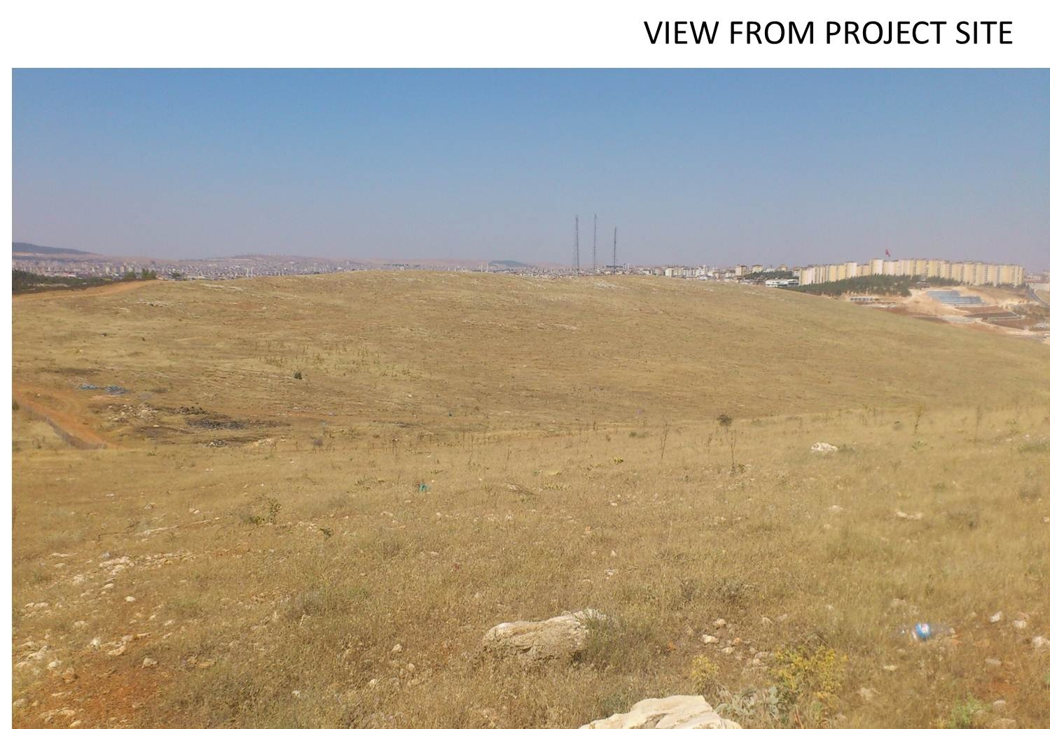
axonometry

Slide 8
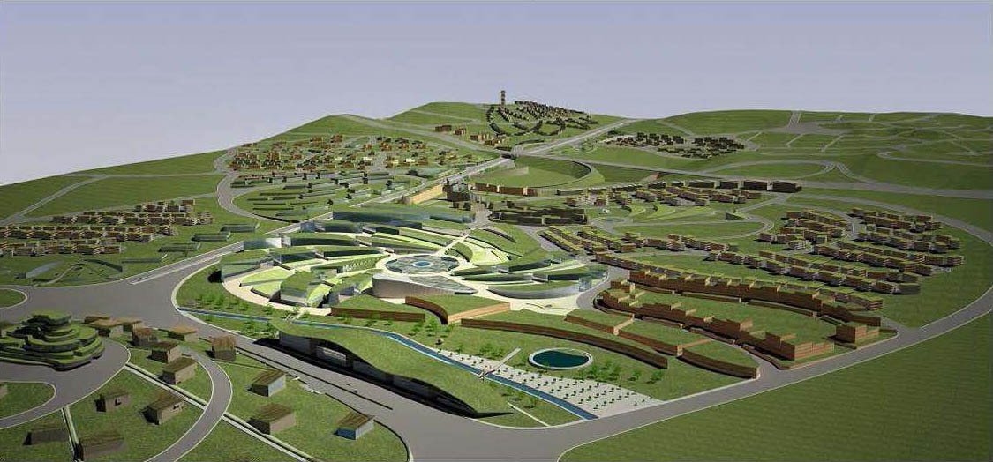
Invitation for Competition Submissions
ISOVER Multi
-
Comfort House Students Contest
Edition 2014
:
School of tomorrow
-
Gaziantep
International, two
-
stage, open competition
2
Acknowledgments:
Special thanks to the City Administration
Office
of GAZIANTEP
for all support during the drafting of this
task.
Content
1. General information
3
1.1. Contents of the c
ompetition
3
1.2. Who can participate
3
1.3
. Awarding organization
4
1.4. Form and organization of the competition
4
1.5. Prize money
4
1.6. Time schedule
5
1.7. National jury
5
1.8. International jury
5
1.9. Trans
port and travel expenses
6
1.10. Legal
6
1.11. Possible collaboration
6
2. Details of the task
7
2.1.
General information about the area covered by the contest
7
2.2.
Site and z
oning requirements
7
2.3.
Projec
t specifics
8
2.4. Type of construc
t
ion, technical parameters
10
2.5.
Competition requirements
13
3
. Fo
rmalities for submission
14
3.1. National stage
14
3.2. International stage
1
4
3
1. General information
1
.1. Content
of the competition
Under the Kyoto Protocol, more than 140 industrial nations have made a commitment to reduce their CO2
emissions drastically and agreed that the usage of energy
-
saving technologies it is a top priority in order to
save our na
tural resources.
Overall, the building sector is responsible for 40% of the total energy consumption and
CO
2
emissions
in
the world demanding a new way of designing each new project and each new renovation.
As the
world
is becoming increasingly urban, a
nd cities are becoming larger and more densely
populated
t
hus
increasing our energy consumpt
ion as well as the
CO
2 emission
.
Reacting to this
situation
,
more
and
more local authorities are demanding for their new development
projects, designs that
fulfil
the highest requirements in terms of energy efficiency while providing the highest
comfort possible for their inhabitants.
It is the case
Metropolitan Municipality of Gaziantep,
Turkey,
which
have decided to implement, Gaziantep
Climate Change Action Plan
, initiative that aims to improve the life of its citizens towards sustainability and
making Gaziantep a pioneer countrywide in sustainability policies.
Following this policies, the Municipality of Gaziantep
, Turkey,
have
decided to start the development
of the
ECO Project for approximately 200
000 inhabitants.
T
he urban administration
decided that
this project
should not only
provide the lowest possible energy consumption
for the fu
ture inhabitants but also the
highest degree of comfort.
One key issue of
this development is the attention given to children and to their education.
T
he participants
to ISOVER Multi
-
Com
fort House Students Contest 2014
Edition
design a school that
combined classical school elements with modern learning facilities taking in to a
ccount the existing realities
for the new
ECO Project
developed by the
Municipality of Gaziantep
, Turkey.
The school
dedicated to
children between the
ages of 6 to 10 will accommodate a number of 400 to 600
students.
1.2. Who can
participate?
Partic
ipants can be
students of architecture, design and construction engineering from universities
of
all
countries with ISOVER,
CertainTeed and Izocam presence and where this competition i
s he
ld.
Participation is open for all students from 1
st
to 6
th
year of s
tudy
as an individual
or in teams of up to 3
team
members
.
A student cannot be part of
two different teams submitting projects for the
same edition of the contest
.
Only
one project may be submitted per team
.
Invitation for Competition Submissions
ISOVER Multi
-
Comfort House Students Contest
Edition 2014
:
School of tomorrow
-
Gaziantep
International, two
-
stage, open competition
2
Acknowledgments:
Special thanks to the City Administration
Office
of GAZIANTEP
for all support during the drafting of this
task.
Content
1. General information
3
1.1. Contents of the c
ompetition
3
1.2. Who can participate
3
1.3
. Awarding organization
4
1.4. Form and organization of the competition
4
1.5. Prize money
4
1.6. Time schedule
5
1.7. National jury
5
1.8. International jury
5
1.9. Trans
port and travel expenses
6
1.10. Legal
6
1.11. Possible collaboration
6
2. Details of the task
7
2.1.
General information about the area covered by the contest
7
2.2.
Site and z
oning requirements
7
2.3.
Projec
t specifics
8
2.4. Type of construc
t
ion, technical parameters
10
2.5.
Competition requirements
13
3
. Fo
rmalities for submission
14
3.1. National stage
14
3.2. International stage
1
4
3
1. General information
1
.1. Content
of the competition
Under the Kyoto Protocol, more than 140 industrial nations have made a commitment to reduce their CO2
emissions drastically and agreed that the usage of energy
-
saving technologies it is a top priority in order to
save our na
tural resources.
Overall, the building sector is responsible for 40% of the total energy consumption and
CO
2
emissions
in
the world demanding a new way of designing each new project and each new renovation.
As the
world
is becoming increasingly urban, a
nd cities are becoming larger and more densely
populated
t
hus
increasing our energy consumpt
ion as well as the
CO
2 emission
.
Reacting to this
situation
,
more
and
more local authorities are demanding for their new development
projects, designs that
fulfil
the highest requirements in terms of energy efficiency while providing the highest
comfort possible for their inhabitants.
It is the case
Metropolitan Municipality of Gaziantep,
Turkey,
which
have decided to implement, Gaziantep
Climate Change Action Plan
, initiative that aims to improve the life of its citizens towards sustainability and
making Gaziantep a pioneer countrywide in sustainability policies.
Following this policies, the Municipality of Gaziantep
, Turkey,
have
decided to start the development
of the
ECO Project for approximately 200
000 inhabitants.
T
he urban administration
decided that
this project
should not only
provide the lowest possible energy consumption
for the fu
ture inhabitants but also the
highest degree of comfort.
One key issue of
this development is the attention given to children and to their education.
T
he participants
to ISOVER Multi
-
Com
fort House Students Contest 2014
Edition
design a school that
combined classical school elements with modern learning facilities taking in to a
ccount the existing realities
for the new
ECO Project
developed by the
Municipality of Gaziantep
, Turkey.
The school
dedicated to
children between the
ages of 6 to 10 will accommodate a number of 400 to 600
students.
1.2. Who can
participate?
Partic
ipants can be
students of architecture, design and construction engineering from universities
of
all
countries with ISOVER,
CertainTeed and Izocam presence and where this competition i
s he
ld.
Participation is open for all students from 1
st
to 6
th
year of s
tudy
as an individual
or in teams of up to 3
team
members
.
A student cannot be part of
two different teams submitting projects for the
same edition of the contest
.
Only
one project may be submitted per team
.
situation

Slide 9
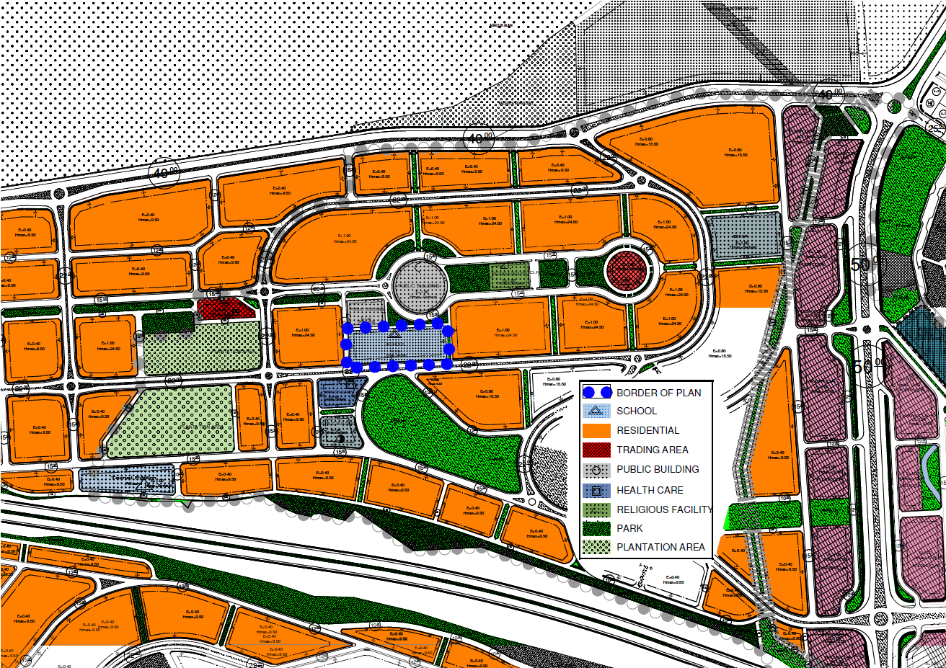

Slide 10
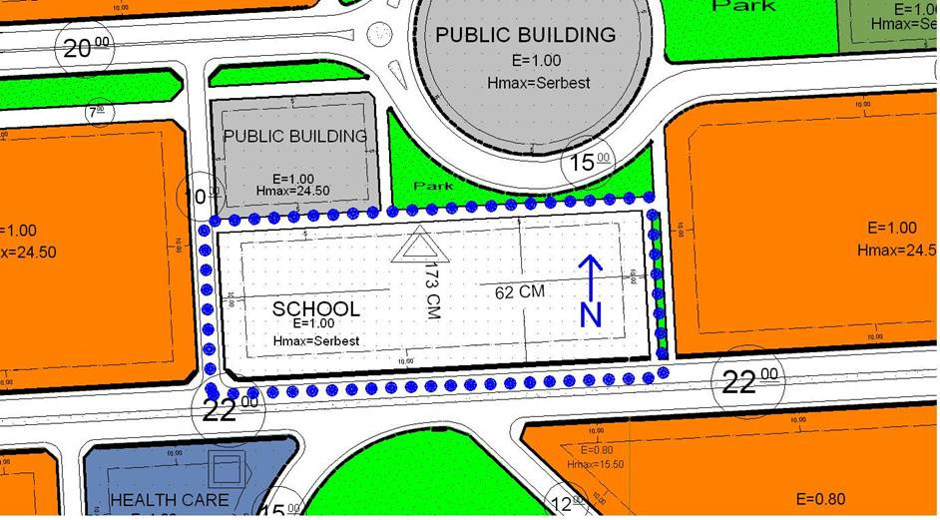
site plan

Slide 11
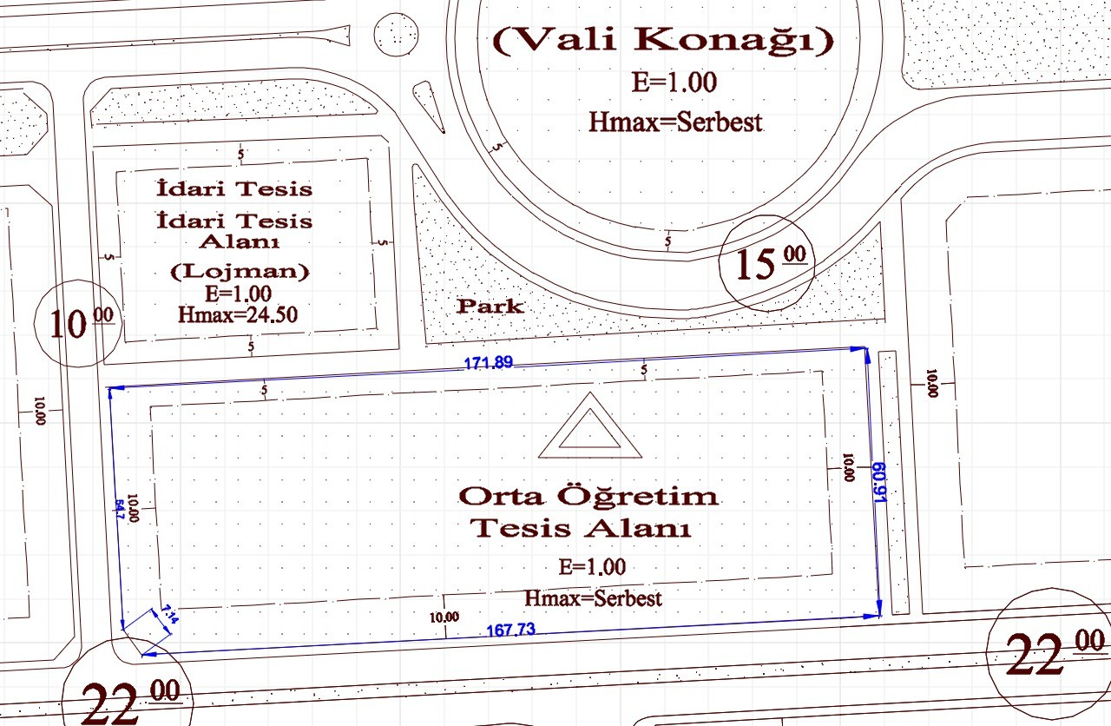
plot dimension

Slide 12
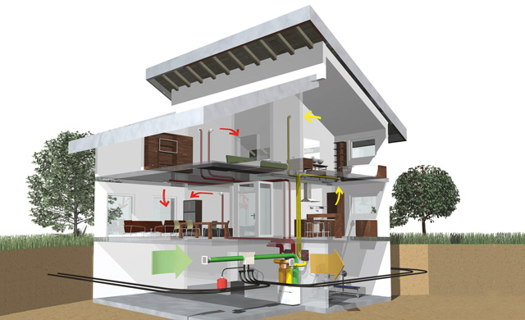
Design and functional concept - Creative approach to the structure of the building
- Functionality and quality of formal design
- Connection to the existing urban area
ISOVER Multi-Comfort-House
- Climate adjusted design concept
- Total energy consumption concept (passive house technology)
- Thermal quality of the building envelope
Passive and active solar gains (winter situation)
Summer conditions
- Acoustic comfort
Sustainability, additional aspects
Economical and social aspects
Accessibility
- Exposure and lighting concept
Green space design
Renewable energy sources
criteria

Slide 13
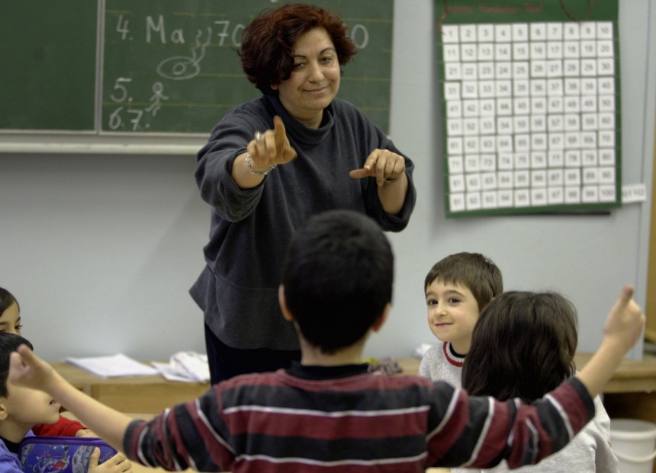
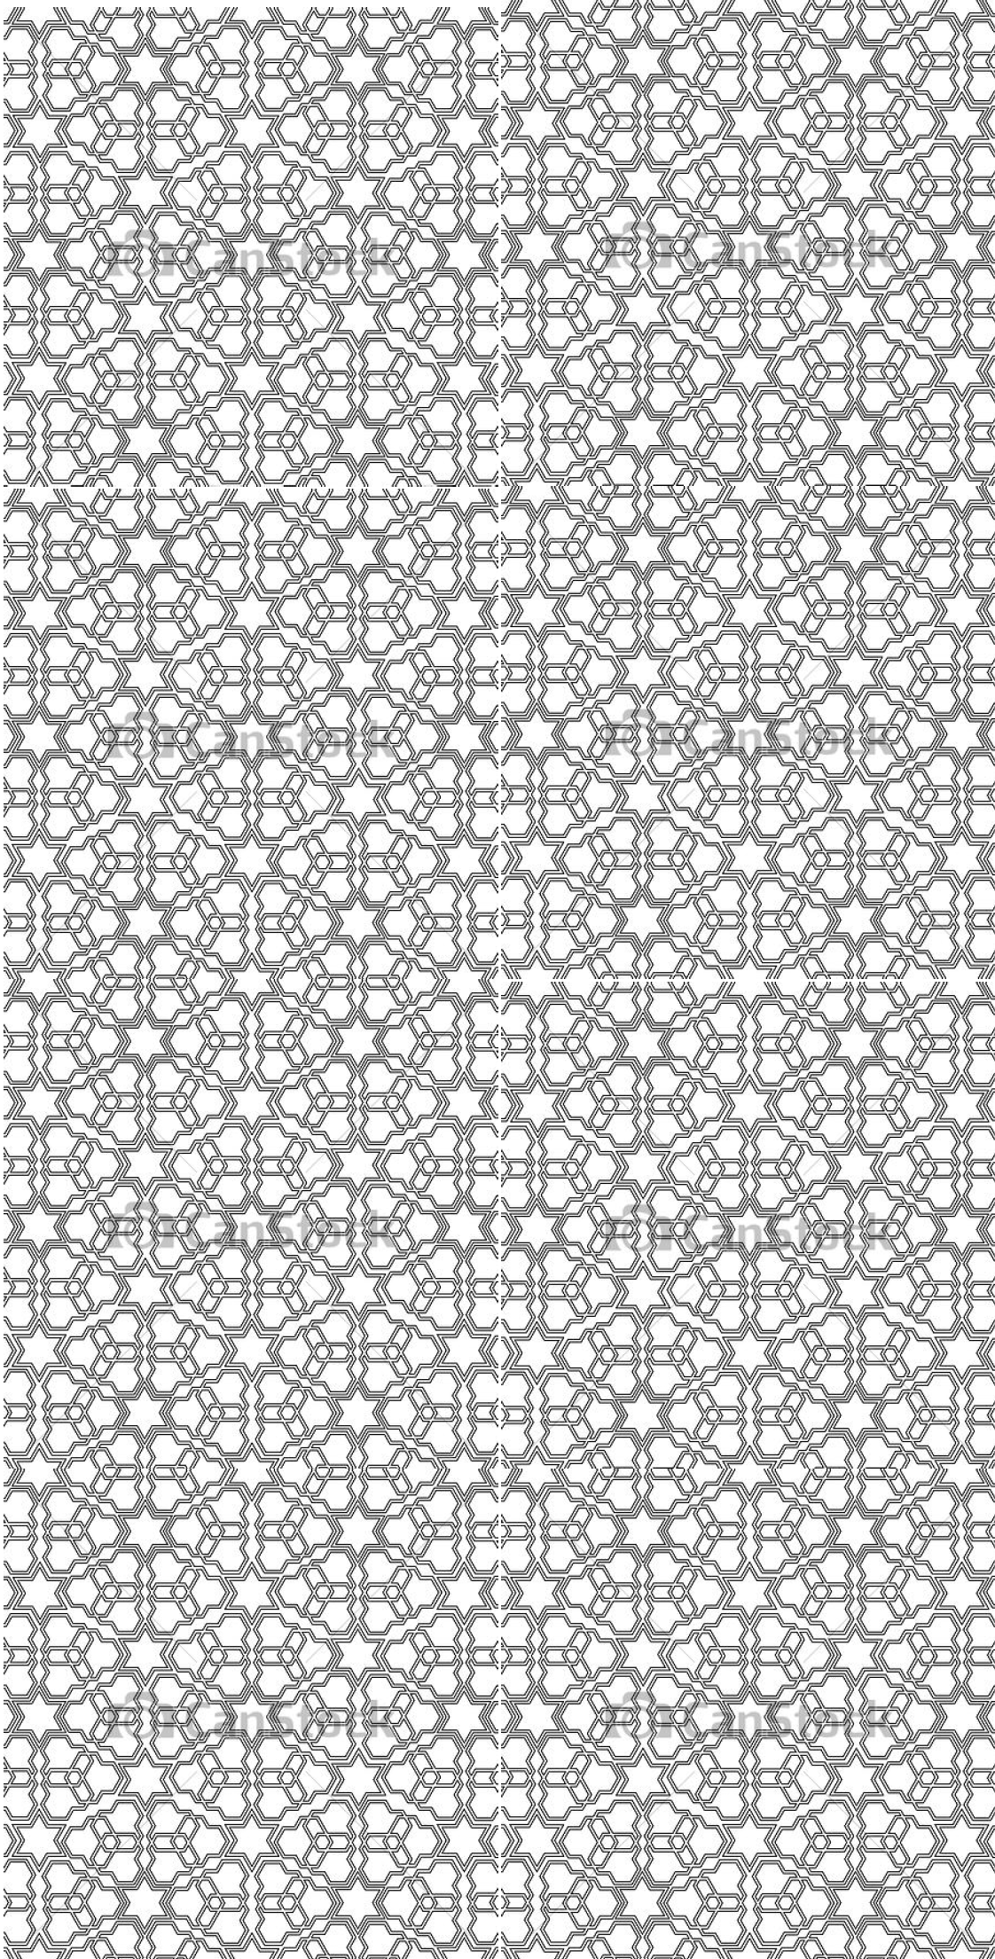
Es gibt nur eins, was auf Dauer teurer ist als Bildung - keine Bildung.
(Max Planck)
Um eine Kultur zu schaffen, genügt es nicht, mit dem Lineal auf die Finger zu klopfen. (Albert Camus)
Die Geschichte lehrt dauernd, aber sie findet keine Schüler. (Ingeborg Bachmann)
In der Schule gabs für mich nur Höhen und tiefen. Die Höhen waren der Fußball.
(Thomas Häßler)
Lieber sechs Stunden Schule als gar keinen Schlaf.
(Schülerweisheit)
Another brick in the wall …..
(Pink Floyd)

Slide 14
Descriptions
Function, design concept and explanations (organigramm)
Description of the design concept
Description of construction
Energy supply and ecological concept (optionally with graphic illustration)
List of constructions details with U-values
- Results of simulations and calculations
- Explanation of all thermal and acoustic properties in the table
Plans
- Plan of site 1:500
- Floor plan and cross-section 1:100
- Horizontal façade cross-section 1:50
- Vertical façade cross-section 1:50
- Strip view of south façade 1:50
- Construction details 1:20
Renderings and /or photos
of the model
requirements

Slide 15
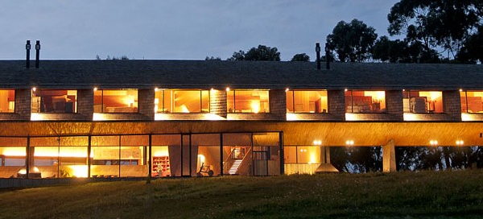
KICK-OFF WORKSHOP
March 10, 9:00
Seminarraum 6 - Description & discussion of competition
(Stieldorf, Berthold)
- Passive house standard (IG Passivhaus, ISOVER)
- Thermal simulation (HWB, Sommertauglichkeit)
- Housing technology / renewable energies
- Building Assessment
TEACHING
Mondays, 9:00 am
Semr. 1 und/oder 6 / 253.4 HB1:
Karin Stieldorf karin.stieldorf@tuwien.ac.at
Manfred Berthold
HB2:
Klaus Krec
Statik: Marjan Maftoon
FINAL SUBMISSION
NATIONAL JURY
2014 May, 19
schedule

Slide 16
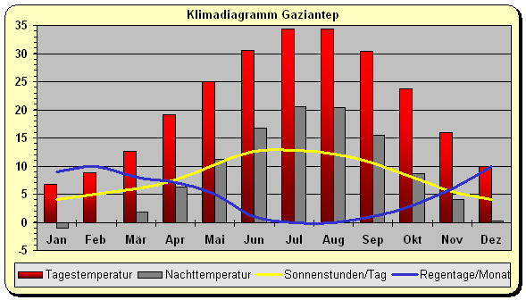
Klimadaten Türkei / Gaziantep
Lokalzeit (GMT+2)
http://www.iten-online.ch/klima/europa/tuerkei/gaziantep.htm

Slide 17
Infos
Österr. Institut für Schul- und Sportstättenbau ÖISS
http://www.oeiss.org/
Studien
Schul:FREI - Empfehlungen für die Gestaltung von Schulfreiräumen Vergleichsstudie der österreichischen Schulbaurichtlinien
Richtlinien:
Arbeitsverhalten und Arbeitsplätze im Unterricht - in Überarbeitung Außenraum - Schulfreiräume (Unterkapitel der Schulbaurichtlinien) Bauphysik, Raumklima und Energieeffizienz (Unterkapitel der Schulbaurichtlinien) Bebauung, Erschließung, Raumorganisation und Flexibilität (Unterkapitel der Schulbaurichtlinien) Heizungs-, Klima-, Lüftungs- und Sanitäranlagen (Unterkapitel der Schulbaurichtlinien) Lage, Situation, Bauplatz und Aufschließung (Unterkapitel der Schulbaurichtlinien)
http://www.schule.at/portale/informations-und-officemanagement/unterrichtsmaterial/detail/-672107475d.html

Slide 18
Leitfaden für Partizipationsprozesse mit Schulen
Material und Oberflächen (Unterkapitel der Schulbaurichtlinien)
Natürliche Belichtung und künstliche Beleuchtung (Unterkapitel der Schulbaurichtlinien)
Raumakustik und Schallschutz (Unterkapitel der Schulbaurichtlinien) Räumliche Anforderungen für Unterrichtsräume (Unterkapitel der Schulbaurichtlinien) Schulbaurichtlinien (Sammelmappe) Sicherheit und gesunde Lernumgebung (Unterkapitel der Schulbaurichtlinien) Ökologische Kriterien im Schulbau
Sonderdrucke
Schulfreiräume - Freiraum Schule Beratungskatalog für Schulen

Slide 19
Exkursion ??
Analyse einer Schule / Gruppe
Vortrag Schule
Prof. Kühn
Karin Schwarz-Fiechtbauer
Erstellung eines Organigramms

Slide 20
http://www.lehrer-info.net/kompetenz-portal.php/cat/17/aid/75/title/Schulsystem_Tuerkei
. . . . . . . . . .
. . . . . . . . . .
Die wesentlichsten Unterschiede zum deutschen Schulsystem:
der formale Aufbau des Schulsystems
die unterschiedlichen Schul- und Ausbildungsabschlüsse
die Lehrpläne (in naturwissenschaftlichen Fächern den deutschen Lehrplänen voraus!)
die Lernmethoden (Disziplin und Auswendiglernen in der Türkei)
die schulische Infrastruktur beider Länder
Wichtige Reformen:
1997 wurden Reformen für das Schulsystem beschlossen:
Die Schulpflicht wurde auf acht Jahre verlängert. (Im vorherigen System waren es fünf Jahre.)
Die Mittelschule wurde abgeschafft. (Sie konnte vorher an die fünfjährige Grundschule anschließen, ihr Besuch war freiwillig.)
Seit 1998 erfolgt die Zugangsprüfung zur Hochschulausbildung nur noch in einer Stufe (Gymnasialnoten werden weiterhin zusätzlich berücksichtigt).

